Slide 1
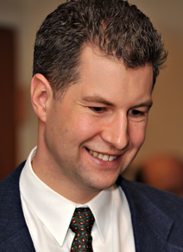

Calling All Astronauts:
Canada’s 2008/09 Astronaut Recruitment Campaign
Dr. Steeves was a top 16 finalist for the recent Canadian Space Agency astronaut recruitment campaign. He will highlight the amazing and unusual challenges faced in the competition, and how his background as an experimental physicist helped prepare him.
Anyone interested in learning about space exploration and the connection with a career in science.
Dr. Geoff Steeves
For more information, contact
Dr. Arnold Sikkema, TWU Physics.
x. 3185, Arnold.Sikkema@twu.ca
Friday 12 March 2010, 11:40am - 12:30pm
Block Hall (Room 148, Neufeld Science Centre)

